Slide 1
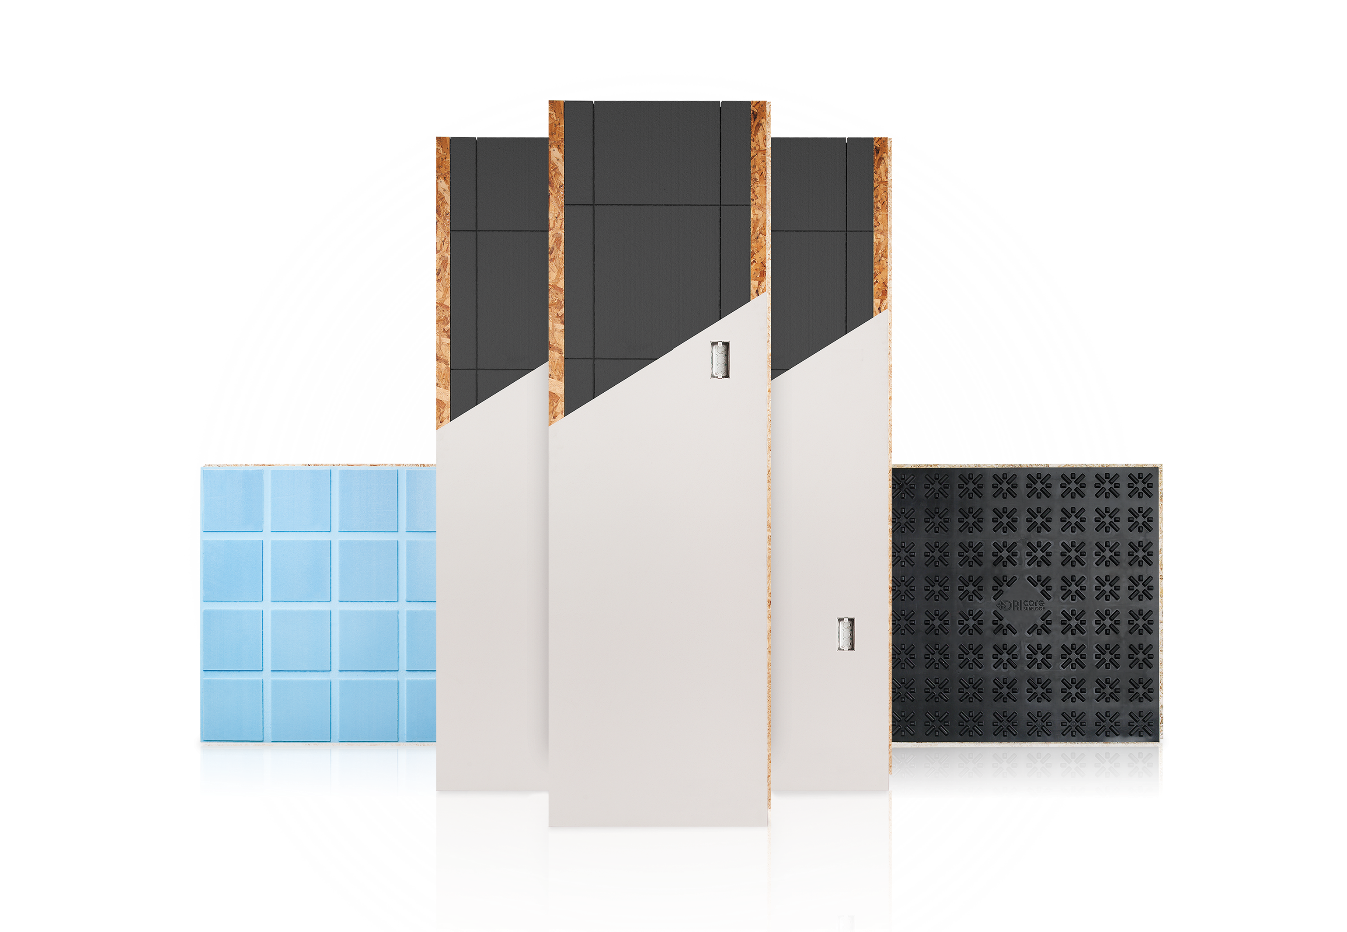
FINISHED BASEMENTS BY
Basement Experts

Slide 2
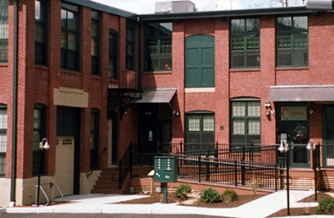
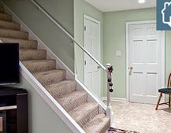
BASEMENT EXPERTS
BASEMENTS BY
Focused on quality, customer communication
Finished basements designed to be as warm, comfortable and enjoyable as your upstairs living space
Materials engineered for the basement environment

Slide 3
BASEMENT EXPERTS
BASEMENTS BY

Slide 4
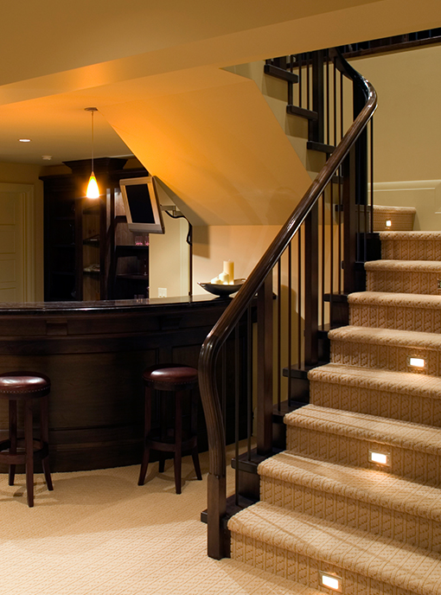
BASEMENT EXPERTS
BASEMENTS BY

Slide 5
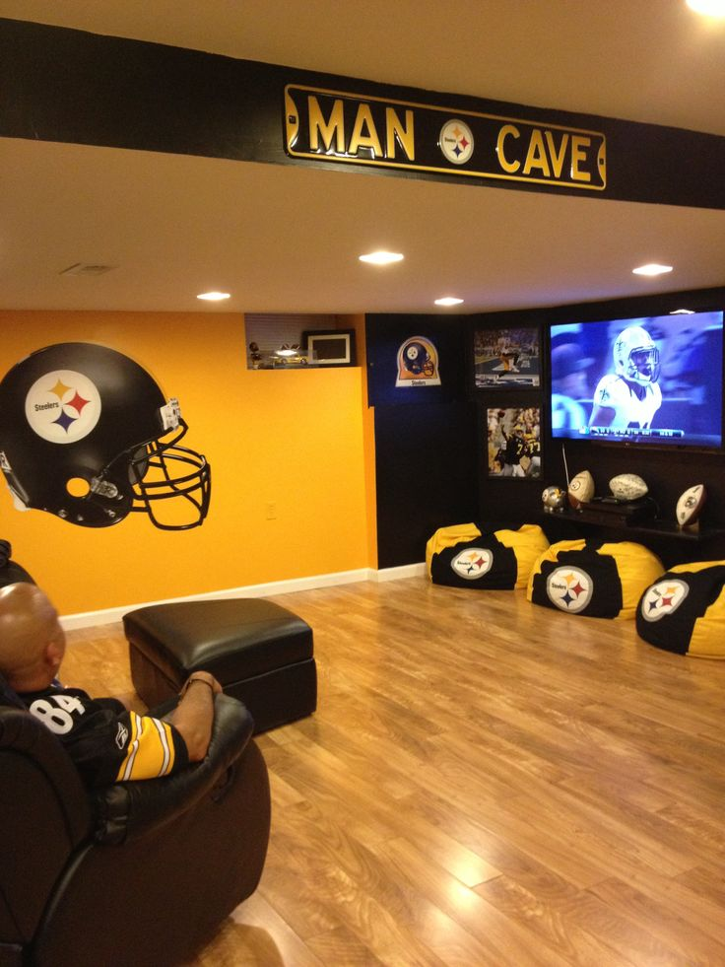
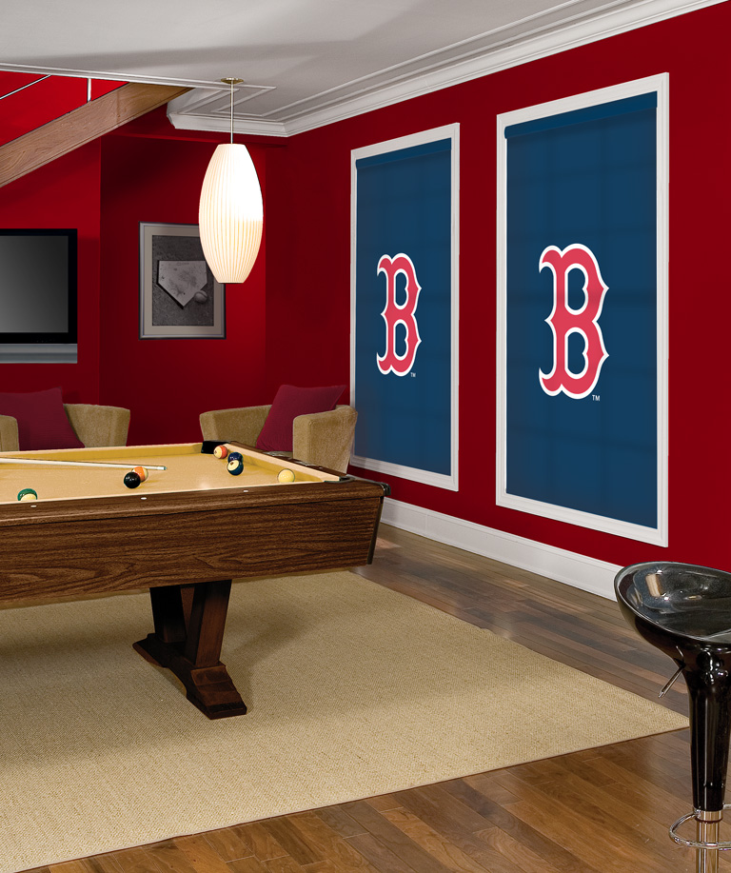
BASEMENT EXPERTS
BASEMENTS BY

Slide 6
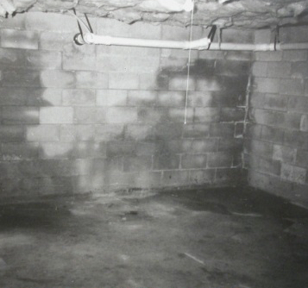
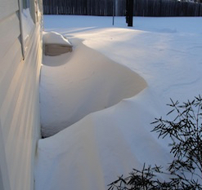
CHALLENGES
BASEMENT FINISHING
Wet
Cold

Slide 7
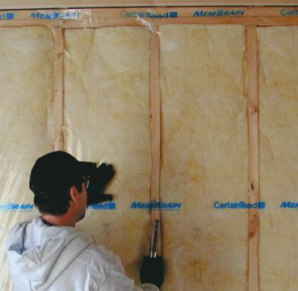
TRADITIONALLY
BASEMENT FINISHING
Studs – Steel or wood
Batt Insulation
Vapor Barrier

Slide 8
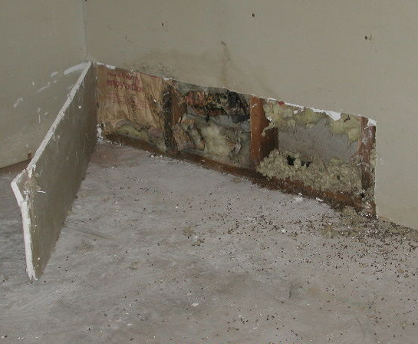
MOISTURE AND TRADITIONAL CONSTRUCTION
"Continued use of these approaches by the home building industry will likely lead to a disaster of unprecedented proportions and may result in the construction of energy efficient homes being set back a generation.”
- Buildingscience.com
“Traditional construction below grade has been described as “A mold incubation chamber”
- Johnathan Straube, Waterloo, U

Slide 9
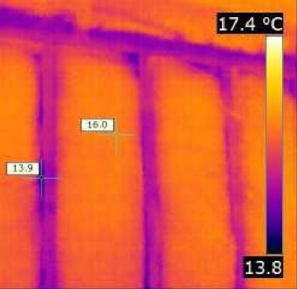
R-VALUE AND TRADITIONAL CONSTRUCTION
R-value is the capacity of insulating material to resist heat flow
Wood and steel studs have extremely low R-value
Even with high R-value batt insulation, studs reduce the overall R-value of the wall
1
2
3
4
Wood studs reduce R - Value by 30%
5
Steel studs reduce R – Value by 50%
Thermal Image

Slide 10
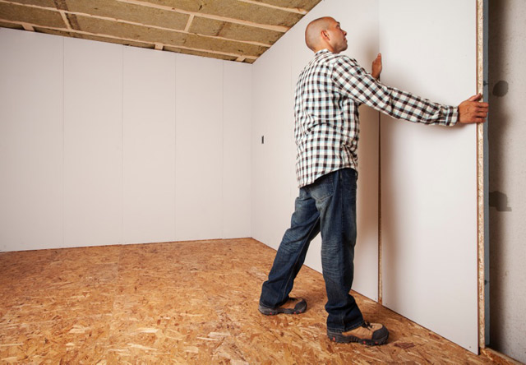
BASEMENT EXPERTS
SMARTWALL
We install a premium wall product specifically engineered for the basement environment. Unlike other “systems” Smartwall looks and performs like every other wall in your home but with a Critical feature that benefits You.

Slide 11
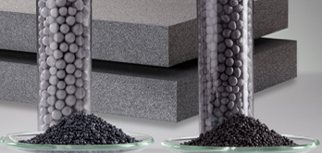
SMARTWALL INSULATION
1
Closed Cell
Graphite Infused
Cold Activated
Green Guard Certified
R-17
2
3
4
5

Slide 12
ENGINEERED FOR BASEMENTS
Allows vapor to exit
No condensation
Drastically inhibits:
-Mold
-Mildew
-Structural Damage
WET

Slide 13
ENGINEERED FOR BASEMENTS
Continuous R-17 Insulation
Improves energy efficiency
Saves Money
Meets increasingly stringent building codes
COLD

Slide 14
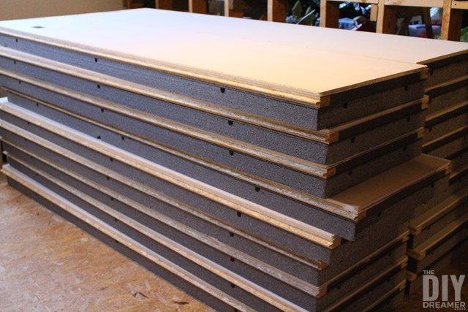
ENGINEERED FOR BASEMENTS
Efficient, clean install
Completely seamless
Exceeds thermal and flame spread standards
Approved by the Canadian Construction Materials Center
Approved by the International code council

Slide 15
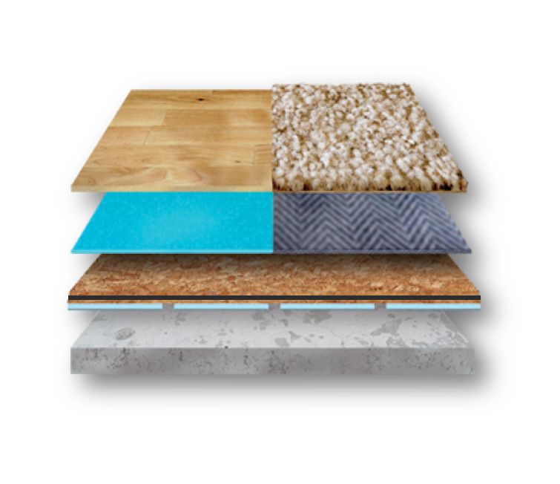
ELEVATING AND INSULATING FLOORING
Concrete floors are cold, hard and wet
Elevating finished flooring off the concrete with DRIcore’s R+ has three key benefits
Raises finished floor temperature by 10ºF (R3)
Provides softer finished floor
Protects finished flooring from normal basement moisture issues
Ideal for all flooring types
1
2
3
4

Slide 16
BASEMENT EXPERTS
Make the right choice for your home, health and family. Give yourself the peace of mind knowing that you made the Smart choice and begin creating the best memories in your newly finished basement.

Slide 17
THANK YOU

